Slide 1


Analyzing News of current events
using the GDELT Database
Aditya Mehta
MSc Data Science (2022)
University of Aberdeen
Under the Guidance of
Dr. Marco Thiel
University of Aberdeen

Slide 2
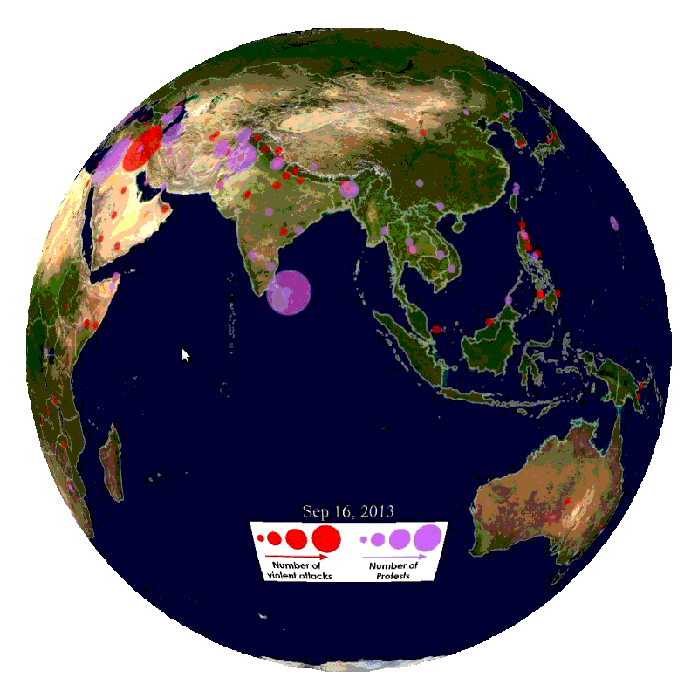


Introduction to GDELT Project
The GDELT Project is a Realtime network diagram and database of global human society for open research
The GDELT Event Database records over 300 categories of physical activities around the world, from riots and protests to peace appeals and diplomatic exchanges, georeferenced to the city or mountaintop, across the entire planet dating back to January 1, 1979, and updated every 24 hours.
It moves beyond the focus of the Western media towards a far more global perspective on what's happening and how the world is feeling about it.
My motivation behind choosing this project
Mission & goals
Opportunity to work with real time & real-world data
Challenge to explore and analyze huge dataset stretching over a million rows and >50 attributes
To experience working on a broad global level affecting regions, sentiments of population, magnitude of news
To form a well-defined news dashboard in order of significance with machine learning for recommendation and suggestions.
To capture Global scenario stats over news distribution.
Transforming raw literature data to an understandable reports and chart, easily comprehensible to non-industry individuals

Slide 3



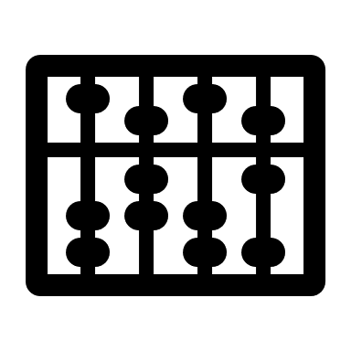





Project Overview
Phase 1
Phase 2
Phase 3
Data Exploration & Database setup
Data Analysis & Machine learning
Data Visualization, Report Generation & Conclusion
Exploring data offered by GDELT project and formatting in order to build a data pipeline
Initialize automation script for data scraping from the website.
Studying datatypes of over 58 attributes of each news source and their properties to further clean, normalize the raw dataset
Forming and uniformly updating SQL Database for both Raw and processed data
Analyzing key attributes such as Average tone, event type, Goldstein scale for each news to gain valuable insights
Segregation of Conflict, Contagion & Climate news type in order of most trending and importance using algorithm
Machine Learning procedures such as Text Analysis, Image classification over the news for better recommendations.
Geographical charts and summary reports formation from highly processed data received from phase 2
Top & trending News broadcast over period of 24 hrs., 5 days, 10 days.
Final Dashboard generation and conclusion.
3

Slide 4
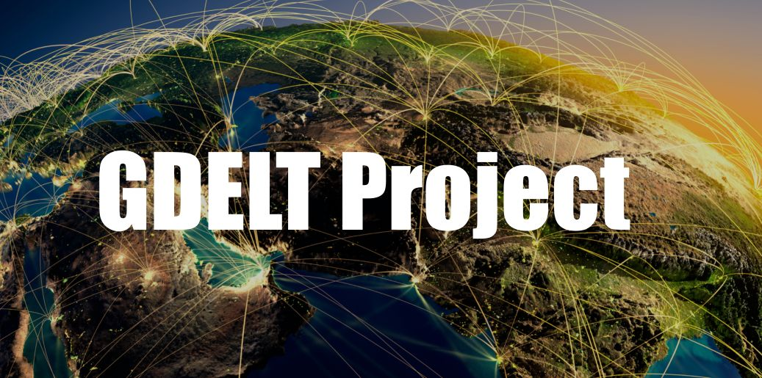




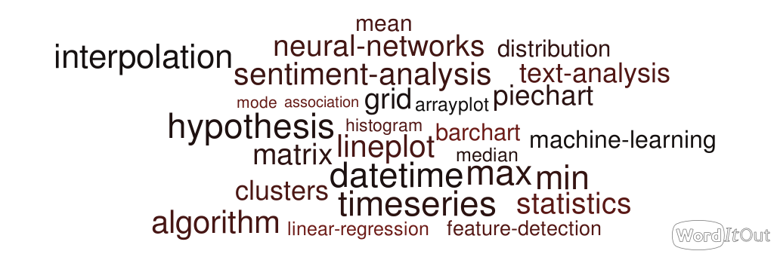




Architecture
Phase 1 : Data Exploration & Database setup
GDELT Database with most updated records
CSV format data stretching over 80k-100k rows for every single day
Mathematica data scraping automation and data exploration
Raw DB formed in MySQL with all 58 variables (columns)
Data extracted from DB for cleaning and structuring
Processed DB formed, ready for data analysis
Phase 2 : Data Analysis & Machine learning
Final processed data stored for visualization
Phase 3 : Data Visualization, Report Generation & Conclusion
Geographical charts, reports, histograms ,timeseries plot
Uploaded to cloud where it is easily accessible by users

Slide 5
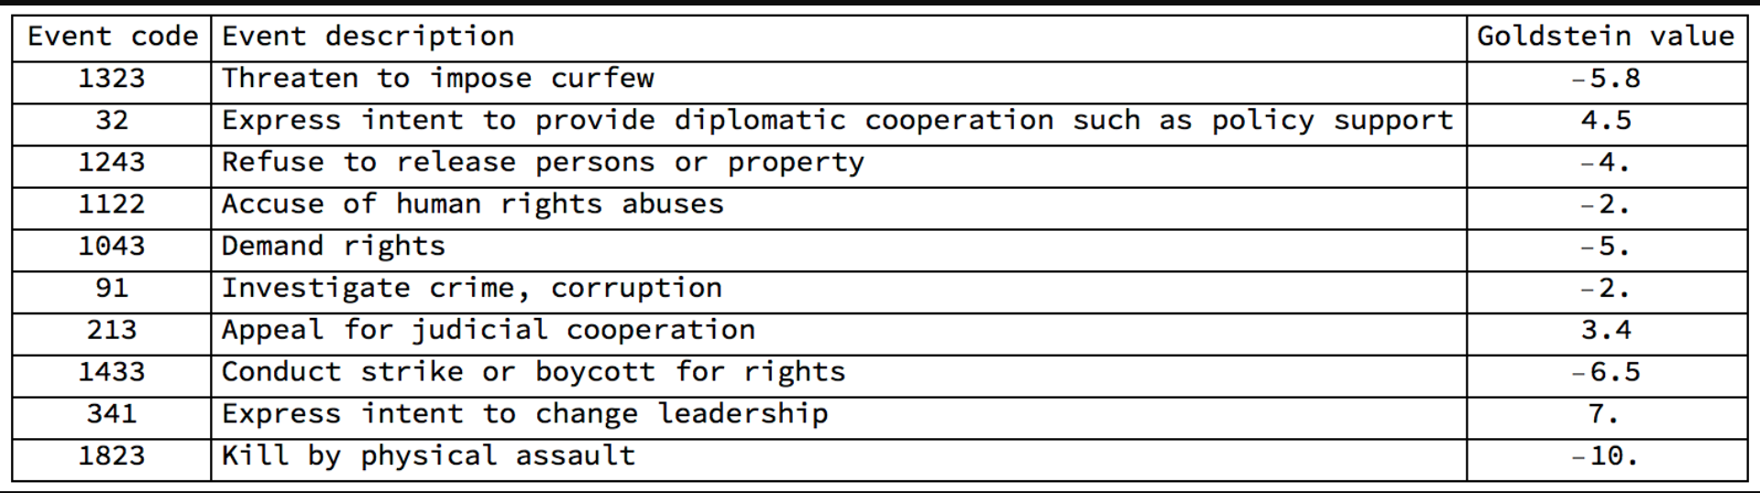
Overview of GDELT data
Actor1Geo_Type
Actor1Geo_FullName
Actor1Geo_CountryCode
Actor1Geo_ADM1Code
Actor1Geo_Lat
Actor1Geo_Long
Actor1Geo_FeatureID
Actor2Geo_Type
Actor2Geo_FullName
Actor2Geo_CountryCode
Actor2Geo_ADM1Code
Actor2Geo_Lat
Actor2Geo_Long
Actor2Geo_FeatureID
ActionGeo_Type
ActionGeo_FullName
ActionGeo_CountryCode
ActionGeo_ADM1Code
ActionGeo_Lat
ActionGeo_Long
ActionGeo_FeatureID
All 58 variables of a particular single news article is classified into 5 major categories shown below
Actor1Code
Actor1Name
Actor1CountryCode
Actor1KnownGroupCode
Actor1EthnicCode
Actor1Religion1Code
Actor1Religion2Code
Actor1Type1Code
Actor1Type2Code
Actor1Type3Code
Actor2Code
Actor2Name
Actor2CountryCode
Actor2KnownGroupCode
Actor2EthnicCode
Actor2Religion1Code
Actor2Religion2Code
Actor2Type1Code
Actor2Type2Code
Actor2Type3Code
Categorical rundown details such as name, religion, region, political group of the parties involved
Geographical details along with latitude and longitude of the parties involved
ID and timestamp of news recorded in different formats
GLOBALEVENTID
SQLDATE
MonthYear
Year
Fraction Date
ID and timestamp of news recorded in different formats
Source of data (news) and date of addition in registry
Source of data (news) and date of addition in registry
DATEADDED
SOURCEURL
IsRootEvent
EventCode
EventBaseCode
EventRootCode
QuadClass
GoldsteinScale
NumMentions
NumSources
NumArticles
AvgTone
Analysis data,
Magnitude, references, average tone of a particular article or news
Analysis data,
Magnitude, references, average tone of a particular article or news
A direct relation between Event code and Goldstein scale

Slide 6
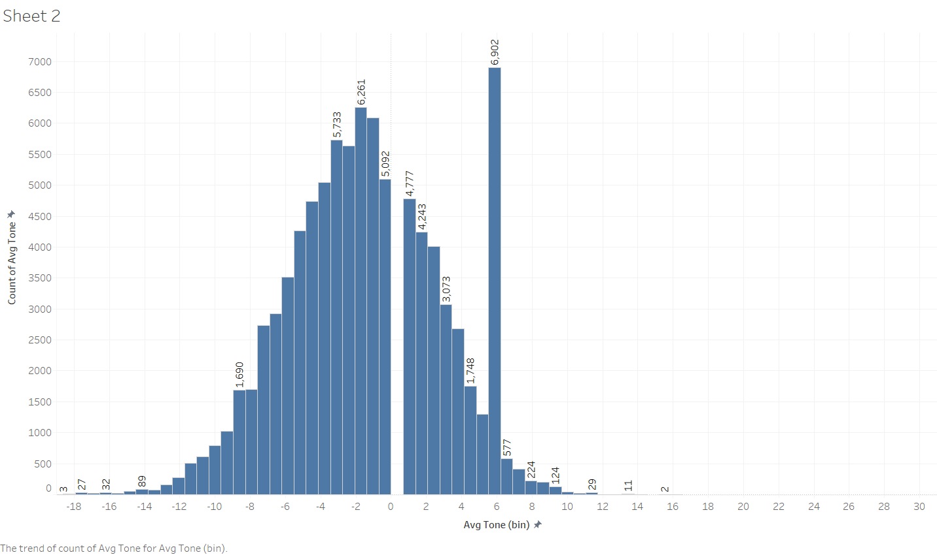
Some Visual Analysis
Histogram plotted of the average tone of news articles (approx. 70,000) for the date 16th January 2023

Slide 7
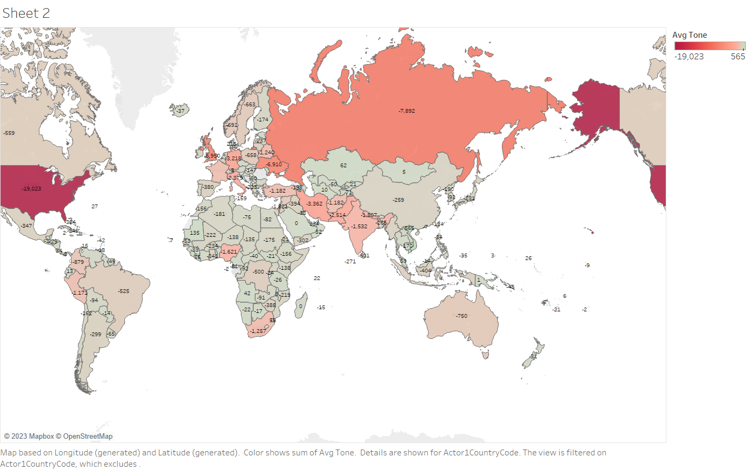
Some Visual Analysis
Geographical plot of the sum of avg tone of news articles against the countries involved(approx. 70,000) for the date 16th January 2023

Slide 8
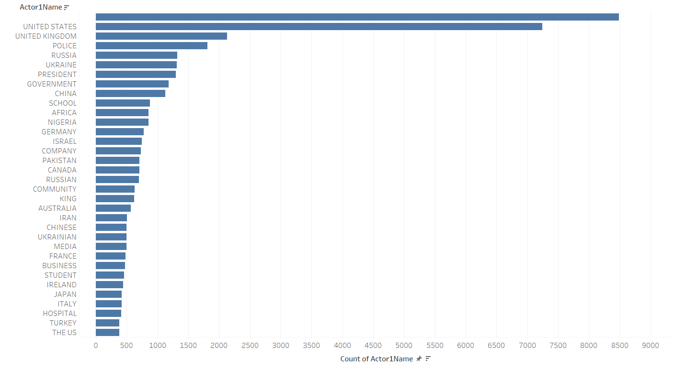
Some Visual Analysis
Histogram plotted of involvement of countries and some groups in the news (approx. 70,000) for the date 16th January 2023

Slide 9
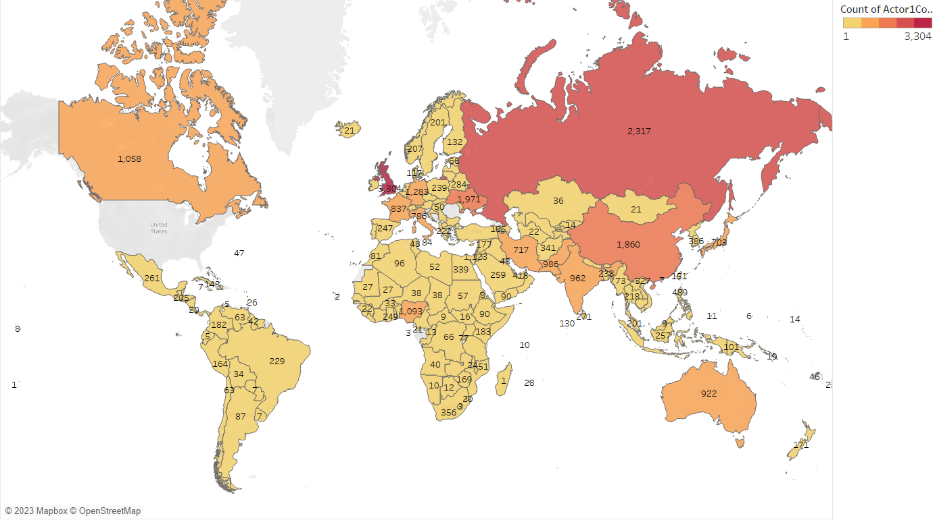
Some Visual Analysis
Geographical plot countries involved in news (approx. 70,000) for the date 16th January 2023

Slide 10
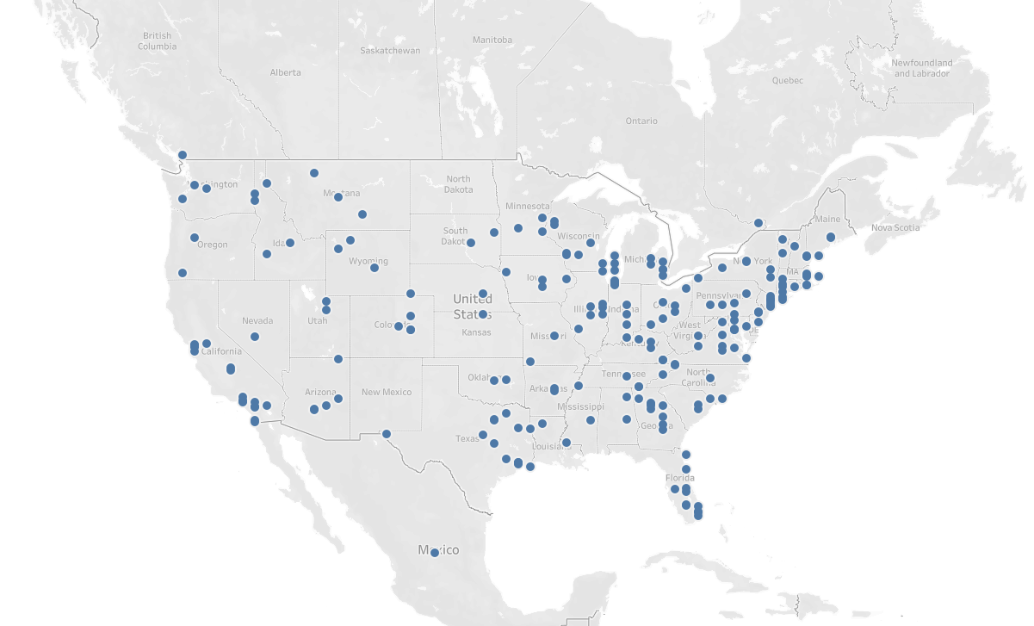
Some Visual Analysis
A more detailed view of cities and states of USA in news of 16th January 2023

Slide 11
References
https://www.gdeltproject.org/
https://community.wolfram.com/groups/-/m/t/1073879

Slide 12
Thank you

